Slide 1

Software Defined Networking An Overview
The Webinar will begin at 2:02
Daniel Schrader
Vyatta, a Brocade Company

Slide 2
Legal Disclaimer
All or some of the products detailed in this presentation may still be under development and certain specifications, including but not limited to, release dates, prices, and product features, may change. The products may not function as intended and a production version of the products may never be released. Even if a production version is released, it may be materially different from the pre-release version discussed in this presentation.
Nothing in this presentation shall be deemed to create a warranty of any kind, either express or implied, statutory or otherwise, including but not limited to, any implied warranties of merchantability, fitness for a particular purpose, or non-infringement of third-party rights with respect to any products and services referenced herein.
ADX, AnyIO, Brocade, Brocade Assurance, the B-wing symbol, DCX, Fabric OS, ICX, MLX, MyBrocade, OpenScript, VCS, VDX, and Vyatta are registered trademarks, and HyperEdge, The Effortless Network, and The On-Demand Data Center are trademarks of Brocade Communications Systems, Inc., in the United States and/or in other countries. Other brands, products, or service names mentioned may be trademarks of their respective owners.

Slide 3
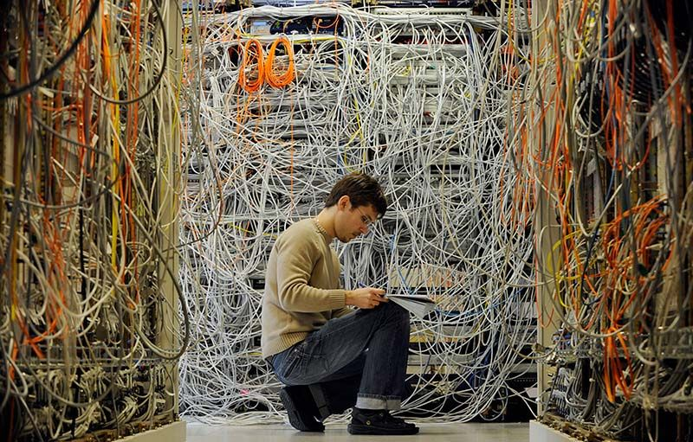
“Data center networks are in my way”
2009, James Hamilton, VP/DE Amazon Web Services
Notes:
James Hamilton – VP & Distinguished Engineer at Amazon Web Services
Gave a presentation in 2009 making a case for networking with merchant silicon, open source protocol & mgmt stack
http://mvdirona.com/jrh/talksandpapers/jameshamilton_cleanslatecto2009.pdf

Slide 4

“It’s hard to make predictions, especially about the future.”
- Yogi Berra

Slide 5
Headlines
Report: Majority of Service Providers
Considering SDN Deployment—ZDnet
“Prediction: OpenFlow Is Dead by 2014; SDN Reborn in Network Management”
—Mike Fratto, Network Computing
“Will OpenFlow commoditize networks? Impact Cisco margins?”
—Several media publications, Bloggers
“SDN Hype or Reality”
PacketPushers
“Hype around SDN/OpenFlow getting way out of Control. Where have I seen this before…” —Ethereal mind, Blogger
“SDN needs a bigger definition”
—Lippis report, 2012

Slide 6
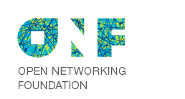
What is SDN?
“…programmable networks (or more precisely, network elements that can be configured through a reasonable and documented API)…”
– Ivan Pepelnjak, ipSpace.net
“Software Defined Networking (SDN) is an emerging network architecture where network control is decoupled from forwarding and is directly programmable…”
– Open Networking Foundation

Slide 7
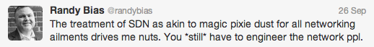

What SDN isn’t…
We still need smart network design. Maybe smarter then we did before.
There’s more to it then just OpenFlow.
Notes:
Randy Bias is founder of CloudScaling, Cloud Computing pioneer
Truman Boyes is in R&D and Bloomberg

Slide 8
So, SDN is all about…
Network Programmability
API interaction with network elements
Separation of Control Plane and Forwarding Plane
Forwarding Plane can be Software or Hardware
Control Plane – agnostic to the underlying hardware
Integration with higher-order Orchestration platforms
OpenStack, CloudStack, vCloud Director
Network topology and orchestration derived from the application / tenant. This is how SDN is different from switched networks.
Vendor Independence – Open Source

Slide 9
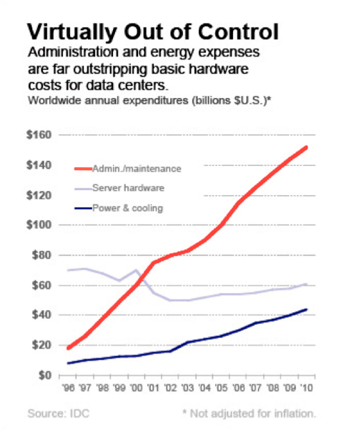
What’s Driving SDN?
SDN is not about Agility
It is not about new services
It’s about the economics of networking
Capital Costs and the “Cisco Tax”
Energy costs
Real-Estate
Operating Costs

Slide 10
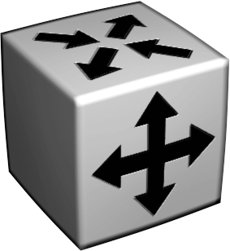
Traditional Network
Control
Control
Forwarding
Forwarding
Control
Control
Forwarding
Forwarding
Control
Control
Forwarding
Forwarding

Slide 11
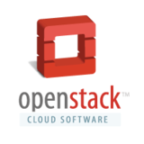
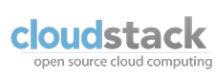
SDN Model
API
API
Control
Control
Control
Forwarding
Forwarding
Forwarding
Forwarding
Control
Control
Forwarding
Forwarding
Forwarding
Forwarding
Control
Control
Forwarding
Forwarding
Forwarding
Forwarding

Slide 12


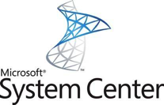


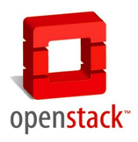



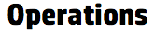
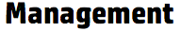
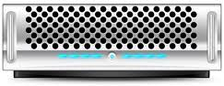

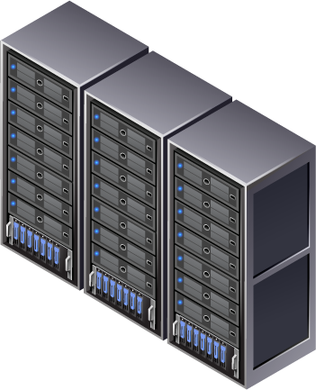


Ecosystem is complex and still emerging
Orchestration/ Monitoring &
Management
vCenter
“NORTHBOUND API”
Rich array of Controllers
Router Control
Security Control
Tunnel/Overlay Technologies
VXLAN
NVGRE
STT
SDN enabled network elements
Notes:
note: the controller itself isn't what's important, it's the applications that sit above the controller that are interesting.

Slide 13
How is SDN used today?
Carrier-grade OpenFlow
WAN Programmability/OpenFlow “paths”
Datacenter Network Virtualization
Research Environments
Notes:
needs for SDN
scale-out multitenancy
service agility
service innovation
long tail use cases - micro use-cases (a vendor probably already tackled the macro use-cases)
network insight
analytics

Slide 14
Why is SDN Important?
Datacenter network topologies are changing (or they need to change)
Virtualization leading to greater Server Density
Changes in traffic flows
Capital cost of infrastructure needs to decrease
NetOps needs to keep pace with DevOps
It’s about the economics of network
Notes:
needs for SDN
scale-out multitenancy
service agility
service innovation
long tail use cases - micro use-cases (a vendor probably already tackled the macro use-cases)
network insight
analytics

Slide 15
Where are the Savings?
TCO Category | SDN Percentage Savings Compared to PMO
 | Service Creation & Insertion | WAN Virtualization | Network Analytics
Network CapEx | 39% | 49% | 13%
Network OpEx | 31% | 38% | 17%
Labor Cost for Order Processing Setup | 77% | 77% | 77%
Labor Cost for Order Processing | 86% | 86% | 86%
TCO | 83% | 61% | 48%
Operational Savings
Infrastructure (Capital) Savings
Improved Agility
Improved Uptime
Better Management
Better Planning
Service velocity is increased by reducing order processing setup time from one year to four months and by a 7:1 reduction in order processing time.
http://www.acgresearch.net/UserFiles/File/Brocade/Brocade%20SDN%20Business%20Case%20Whitepaper_%20ACG%20Research_2013.pdf

Slide 16
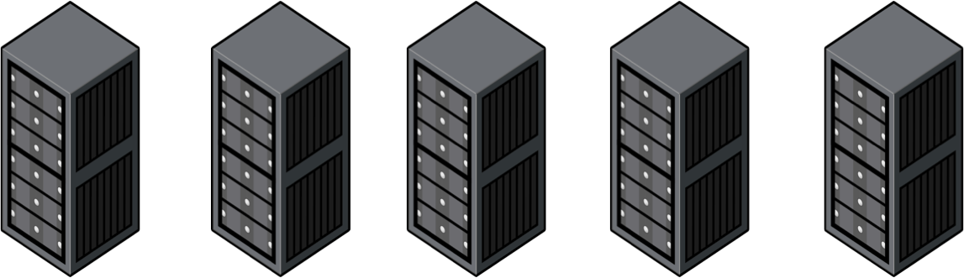
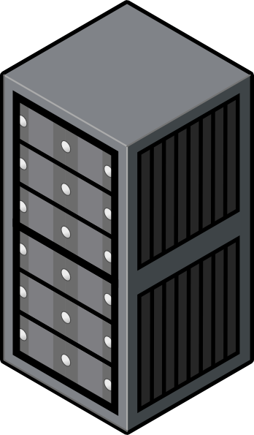
Early SDN Deployment
Network 1
Network 2
Network 3
vSwitch
vSwitch
vSwitch
vSwitch
vSwitch
VM
VM
VM
VM
VM
VM
VM
VM
VM
VM
VM
VM
vSwitch
vSwitch
vSwitch
vSwitch
vSwitch
VM
VM
VM
VM
VM
VM
VM
VM
VM

Slide 17

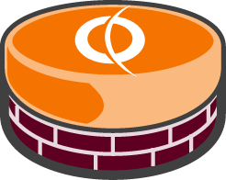
Empowering SDN - Services
Enterprise
Network
Internet
Network 1
Network 2
Network 3
vSwitch
vSwitch
vSwitch
vSwitch
vSwitch
VM
VM
VM
VM
VM
VM
VM
VM
VM
VM
VM
VM
vSwitch
vSwitch
vSwitch
vSwitch
vSwitch
VM
VM
VM
VM
VM
VM
VM
VM
VM

Slide 18

What does Vyatta do?
Vyatta delivers Network Function Virtualization – i.e.
Networking functions – in software
Notes:
What do we do?
Vyatta delivers software-based solutions for networking virtual and cloud infrastructures.
More specifically, Vyatta offers enterprise-class routing and security software that you can use to network your cloud and virtual deployments. Our Mission to help you cut your dependency on proprietary hardware while you build modern enterprise and cloud networks. (and yes, we really do look that good)

Slide 19

Network Function Virtualization
Prod-App
BACKUP NETWORKS
QA-App
Backup
Management
MGMT
NETWORKS
APP TIER
Dev-App
CORE NETWORK
DB TIER
WEB TIER
CORE NETWORK
FWD DMZ
RA-FWD-IF
RA VPN
VDI
NFV allows true virtualization of the network
INTERNET
RA-RWD-IF
REMOTE ACCESS VPN AND VDI TIER FOR ADMINISTRATION
RA-FWD-IF

Slide 20
Virtualize the Network
Prod-App
BACKUP NETWORKS
QA-App
Backup
Management
MGMT
NETWORKS
APP TIER
Dev-App
CORE NETWORK
DB TIER
WEB TIER
CORE NETWORK
FWD DMZ
RA-FWD-IF
Replace hardware networking devices with virtual networking from Vyatta
RA VPN
INTERNET
RA-RWD-IF
REMOTE ACCESS VPN AND VDI TIER FOR ADMINISTRATION
RA-FWD-IF

Slide 21

Capture as a template – step and repeat per tenant
VIRTUAL
PHYSICAL
With NFV you can add, change or remove network devices in software
or virtualize an entire DC
HIGH SPEED BACKPLANE (TB/s)
INGRESS
EGRESS
HIGH SPEED INTERCONNECT TO STORAGE NETWORK
INTERNET
SERVICE PROVIDER
EQUIPMENT
Notes:
Here is the same network laid out in a 30,000 sq ft data center – or the same
Datacenter - virtualized
Solution was architected with blade chassis to provide optimal
Performance
Latency
Redundancy
Blade chassis configured with 4 10G switches for connectivity to backup system and SAN, 2 stacked 1G switches for internet connectivity, 3 half-height blades
Majority of blade traffic travels across chassis backplane.
On average running ~250 VM’s across 3 half-height blades (dual processor dual core 32MB of memory each) for 8 customers and the internal business.
Applications ranges from financial packages, inventory management systems, BI and BPM systems. Largest footprint of VMs were Oracle databases.
At peak average utilization did not exceed 60% across 3 node cluster.
Average ping response 1ms or less.

Slide 22
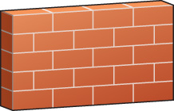

Vyatta Offers
Advanced Routing
Stateful Firewall
Extensive VPN
OSPF, BGP
Stateful, NAT
IPSec, SSL

Slide 23
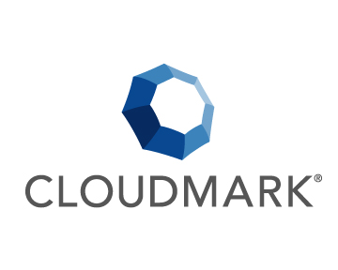
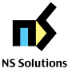

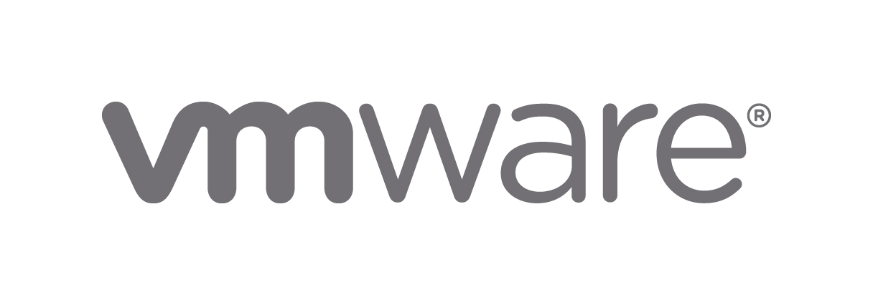











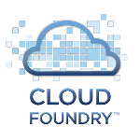



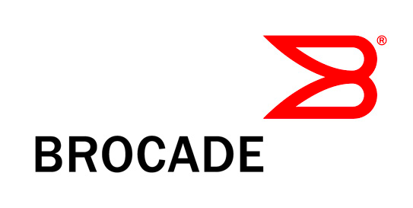



Who is Vyatta?
Leader in software networking
Founded in 2006 on the belief that the future of networking is software
Vyatta is used on 1000s of production networks
Over a million downloads
Vyatta is a Brocade Company

Slide 24





Who Is Vyatta?
Silicon Valley company selling software networking solutions since 2006
Open source product has matured to a robust, feature rich, enterprise proven solution
Server and Hypervisor-agnostic approach enabling agile, capacity-on-demand networks
OpenStack
BGP
Virtual Machine
ESX
OSPF
Router
Firewall
VPN
Xen
VXLAN
HyperV
SOFTWARE
NETWORKING
OPEN
ARCHITECTURES
OPEN
STANDARDS
Notes:
Vyatta is based in Belmont California, in the heart of Silicon Valley.
Vyatta began by taking mature, standards-based open source networking code and providing the additional development to make it easy to deploy and use.
Unlike hardware networking products, Vyatta software-based products can be deployed instantly to create additional network capacity and complexity, enabling on-demand networking.
Running in a virtual machine, Vyatta provides feature-rich routing, including BGP, OSPF, RIP and other protocols, combined with a statefull firewall and VPN.
The product supports most leading hypervisor vendors including Vmware, and will be managed by emerging cloud provisioning tools such as OpenStack.
Vyatta, like Brocade, believes open standards provide the best value to customers, allowing them to select best-of-breed products and avoid vendor lock-in.

Slide 25
Vyatta Highlights
Routing
IPv4, IPv6, Static, PBR, OSPF, RIP, BGP
Security
IPv4, IPv6, Stateful Firewall, NAT
VPN
IPSec, SSL, Route-based, L2-bridging
System Management
CLI, REST API, GUI
IP Services
SSH, DHCP, DNS, SNMP
High Availability
VRRP, Stateful Failover, Config Sync
Platforms
VMware, Xen, KVM, Hyper-V, x86
Notes:
Read through each block: To highlight Vyatta’s breadth, this slide reflects our standards based approach to provide routing (protocols such as BGP, OSPF, RIP…), from a security perspective, we provide stateful firewall, VPN (IPSEC and OPENVPN); threat protection (traffic and web filtering), system management, IP Services in high availability across standard platforms…
(SALES FOLKS: this slide is features and benefits, it is a high level representation of our system, just highlight the ones you know or that make your presentation flow, do not read this slide!)….

Slide 26

Remember When You Used to Get Excited about Networking? It’s that time again
Remember When You Used to Get Excited about Networking? It’s that time again

